Slide 1
CSIS110: Artificial Intelligence

Slide 2

Agenda
What is AI?
Thinking Machines
Natural Language Communication
Knowledge Bases and Expert systems
Pattern Recognition
Machine Learning

Slide 3
What is AI?

Slide 4
Alan Turing
Wrote a landmark paper in 1950 that asked the question “Can machines think?”
Worked between 1938 – 1954
Leader of the group that produced Colossus to crack Nazi codes
Proposed the Turing test
used to empirically determine whether a computer has achieved intelligence
www.loebner.net/Prizef/loebner-prize.html -- $100,000 to win Turing test… nobody yet.

Slide 5
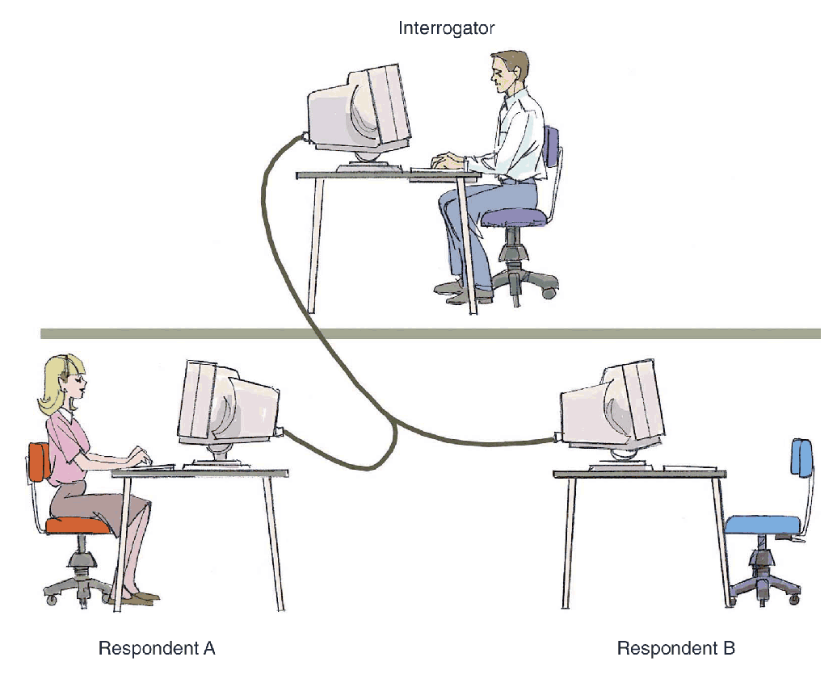
The Turing Test
Figure 13.2 In a Turing test, the interrogator must determine which respondent is the computer and which is the human

Slide 6
AI
The field of computer science devoted to making computers perceive, reason and act in ways that have been reserved for human beings
AI research has produced:
Computers that can communicate in human languages
Systems that can provide instant expertise in medicine, science and other fields
World-class electronic chess players
Robots that can outperform humans in many tasks
AI is a “moving frontier”
Notes:
1950s—AI tried to create computers that could play checkers and chess
“Whatever hasn’t been done yet”

Slide 7
Thinking Machines

Slide 8
Two common approaches to AI
Use computers to simulate human mental process
Problems:
Most people have trouble knowing and describing how they do things
Human intelligence includes unconscious thoughts, insights and other mental processes that are difficult or impossible to understand and describe.
Vast differences between the structure and capabilities of the human brain and the computer
Best way to do something with a machine is often very different from the way people do it
Design intelligent machines independent of the way people think
A computer can do some things better than a human can
Adding a thousand four-digit number – computer could do it in a fraction of a second without error

Slide 9
Domains
Many problems are difficult and too complex to solve all at once, so scientists break those problems into smaller problems that are easier to solve.
They create programs that can function intelligently when confined to limited domains.
Some of the ones we will talk about:
Game playing
Natural language communication
Visual recognition
Expert reasoning

Slide 10
Game Playing
1st popular domains for AI research were checkers and chess.
Easy to represent in memory
Clearly defined rules
Goals are unmistakable – create a program that wins consistently
Developed many AI techniques:
Searching – look ahead at all the possibilities generated by each potential move
Heuristics – rules of thumb
Pattern recognition – Human chess and checkers players remember thousands of critical board patterns and know the best strategies for playing similar patterns
Machine Learning – Learn from experience
Notes:
Machine learning -- If a move pays off, use that move (or similar moves) in future games.

Slide 11
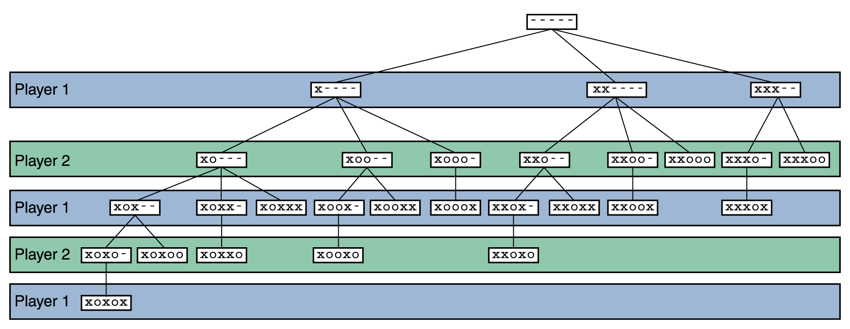
searching
Search tree –represents all possible moves in a game, for both opponents; the paths down a search tree represent a series of decisions made by the players
Early AI programs couldn’t check all possible decision points
Today’s powerful computers can perform massive searches quickly
Complex games like chess require too many searches, so heuristics are used to guide the search

Slide 12
AI has moved on from games
More interesting and practical applications
Vision
Speech
Problem solving
Expert decision making

Slide 13
Language Processing

Slide 14
Natural Language Processing
Three basic types of processing going on during human/computer voice interaction
Voice recognition
Recognizing human words
Natural language comprehension
Interpreting human communication
Voice synthesis
Recreating human speech
Two basic approaches to the solution
Dynamic voice generation
Recorded speech

Slide 15
Automatic Speech Recognition
Techniques used:
Segmenting sound patterns into words
Uses rules for interpreting sounds
Uses context for identifying ambiguous sounds
Learns from a human trainer
Most systems need to be trained to recognize a particular person’s voice
Ideal system:
Speaker independence
Unlimited vocabulary
Continuous speech

Slide 16
Natural Language Communication
Early project – create a program that could translate scientific papers from Russian to English and vice versa
Seemed straightforward:
create a parsing program that could analyze sentence structure and identify each word as subject, verb or other part of speech
create another program to look up each word in a translation dictionary
Gave up after 15 years – only 80% correctly translated
Examples…
“The spirit is willing, but the flesh is weak”
➔ “The wine is agreeable, but the meat is rotten”
“Out of sight, out of mind”
➔ “Blind and insane” or “invisible idiot”

Slide 17
Examples
ELIZA one of the first programs to converse in natural language (1960s)
Uses a few tricks to simulate understanding:
Recognizing a few key words
Identifying categories for some of those words
Repeating phrases from earlier in the conversation
Session can deteriorate into nonsense dialog
Google Translate
Frozen – Do you want to build a snowman?
https://www.youtube.com/watch?v=6mqG5l-9wIE
Shape of You – Ed Sheeran
https://www.youtube.com/watch?v=Rte07sl3Vf4&list=PLGnYtw5ezZI-BnVCUhMOcBqi9KggS1fhD
Facebook apologizes after wrong translation sees Palestinian man arrested for posting ‘good morning’

Slide 18
Why such a problem with natural language?
Computer languages have less than 100 keywords each with a precise, unambiguous meaning
English has hundreds of thousands of words, many with multiple meanings
Natural language programs must deal with rules that are context dependent. These rules for constructing sentences from words are called syntax.
Even more difficult is determining the underlying meaning of words and phrases – semantics.
The computer lacks common sense.

Slide 19
Natural Language Comprehension
Even if a computer recognizes the words that are spoken, it is another task entirely to understand the meaning of those words
Natural language is inherently ambiguous, meaning that the same syntactic structure could have multiple valid interpretations
A single word can have multiple definitions and can even represent multiple parts of speech
This is referred to as a lexical ambiguity
Translation without understanding is impossible – a translator must know what the sentence means
Successful natural language applications limit the domain so that almost all the relevant information can be fed to the system.

Slide 20
Natural Language Comprehension
A natural language sentence can also have a syntactic ambiguity because phrases can be put together in various ways
I saw the Grand Canyon flying to New York.
Referential ambiguity can occur with the use of pronouns
The brick fell on the computer but it is not broken.

Slide 21


Natural Language Comprehension
The boy hit the girl with the bat.

Slide 22
Pattern Recognition

Slide 23
Patterns
Represent many of AI applications:
Face identification
Fingerprint identification
Handwriting recognition
Scientific data analysis
Weather forecasting
Biological slide analysis
Surveillance satellite data analysis
Robot vision
Automatic voice recognition
Expert systems
Identifying recurring patterns in input data with the goal of understanding or categorizing that input.

Slide 24

Image Analysis
Identifying objects and shapes in a photo, drawing, video…
Colorizing classic motion pictures
Require massive amounts of memory and processing power
Complicated by many factors:
Irrelevant data (noise)
Objects that partially cover other objects
Indistinct edges
Changes in light and shadows
Motion

Slide 25
Optical Character Recognition (OCR)
Scanners read letters and numbers that are designed to be easy for a computer to distinguish
Reading from the page of a book, newspaper, magazine or letter is more difficult. Handwritten text is most difficult.
Process of OCR:
Scan the image into the computer
Recognize each character
Convert them to text codes

Slide 26
OCR, continued
Employs several techniques:
Segmentation into pictures, text blocks and individual characters
Use of context to identify ambiguous letters
Learn from examples and human input
Some of the best programs -- ~99 percent accuracy
Reliable enough to be practical for text-intensive applications:
Reading aloud to the blind
Converting typewritten documents to editable text

Slide 27
Machine Learning

Slide 28
Knowledge Bases and Expert Systems
Interesting:
Brain isn’t very good at storing and recalling facts, but is great at manipulating knowledge
Computers are the other way around
Knowledge base:
Contains facts and rules for determining and changing relationships between facts
Difficult to develop a knowledge base that can understand the world the way a child does… (shallow knowledge)
Successful when knowledge bases are restricted to narrow, deep domains
Expert system:
Software program designed to mimic the decision making process of a human expert.
Knowledge base is necessary for any expert system.
A knowledge engineer typically constructs these knowledge bases.
Knowledge is represented in the form of if-then rules

Slide 29
Expert Systems
Example: What type of treatment should I put on my lawn?
NONE—apply no treatment at this time
TURF—apply a turf-building treatment
WEED—apply a weed-killing treatment
BUG—apply a bug-killing treatment
FEED—apply a basic fertilizer treatment
WEEDFEED—apply a weed-killing and fertilizer combination treatment

Slide 30
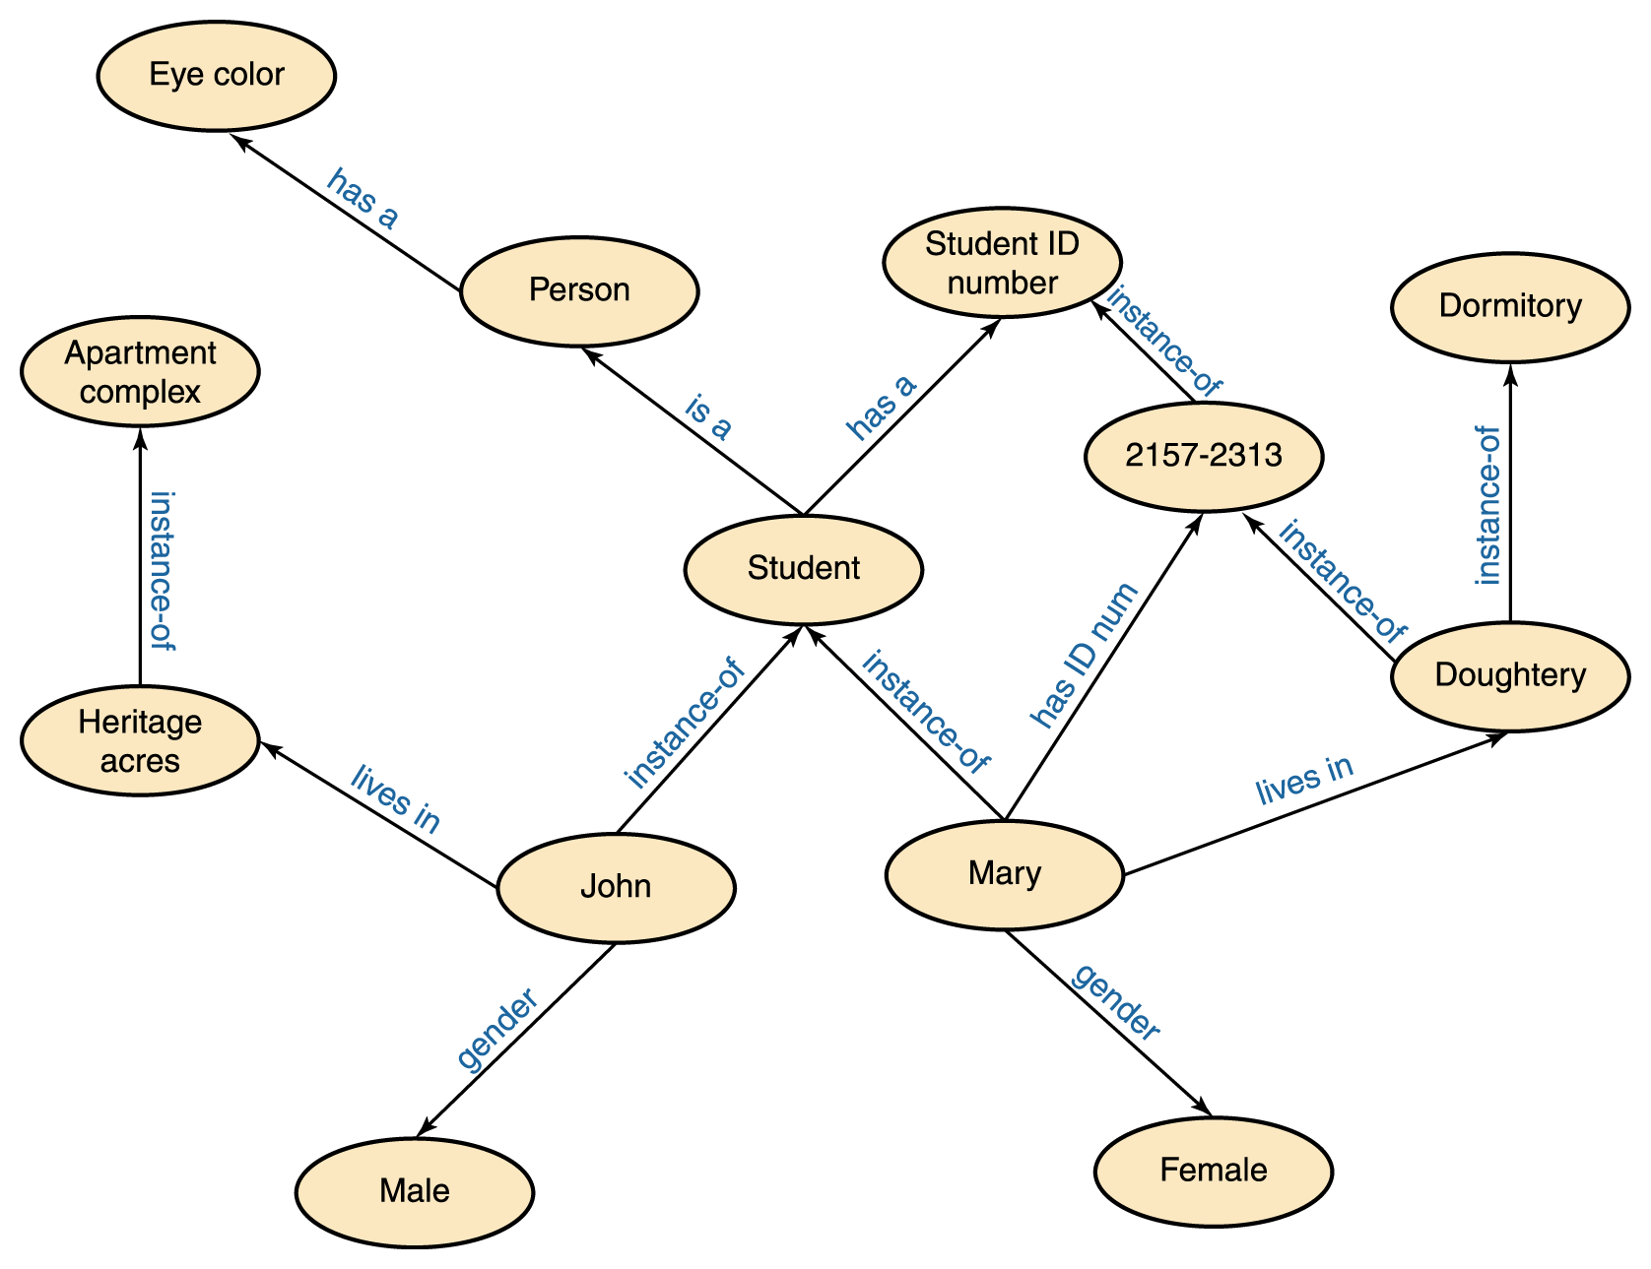
Knowledge Base/Semantic Networks
A semantic network is a knowledge representation technique that focuses on the relationships between objects
A directed graph is used to represent a semantic network or net

Slide 31
Problem – define “bird”
Need to be very specific – for a simple rule like “birds can fly” to be unambiguous:
“Birds can fly, unless they are penguins and ostriches, or if they happen to be dead, or have broken wings, or are confined to cages, or have their feet stuck in cement, or have undergone experiences so dreadful as to render them psychologically incapable of flight.” [Minsky]

Slide 32
Two Machine Approaches
Hand Crafted Rules
Machine Learning
Unsupervised – Unlabeled
Supervised – Labeled
Semi-Supervised

Slide 33
Hand Crafted Rules
Highly effective for static domains
Rely on domain expertise
Accommodating new information is expensive
Does not generalize well
Notes:
The primary deficiency of a hand-crafted rule-based system is its static nature (Hughes, Gose, & Roseman, 1990). Retraining a hand-crafted rule-based system is a manual, and potentially costly, process. As new information arises which requires an update to an Natural Language Processing system, extensive human involvement (e.g., analysis and computer programming) is necessary in order to accommodate new information

Slide 34
Machine Learning
Training Data
Learns in an automated fashion
Creates own rules
Can find patterns which may not be obvious to humans
Notes:
Machine learning, a branch of artificial intelligence, is a scientific discipline that is concerned with the design and development of algorithms that allow computers to evolve behaviors based on empirical data,
A learner can take advantage of examples (data) to capture characteristics of interest of their unknown underlying probability distribution

Slide 35
Machine Learning Algorithms
Neural Networks
Decision Trees
Bayesian
Support Vector Machines
Nearest Neighbor
Genetic Algorithms

Slide 36
Combining Classifiers
Panel of classifiers typically perform better than a single classifier
Can include hand crafted rules
Voting
Weighting
Meta (Algorithmic)

Slide 37
Artificial Neural Network
Neural networks are distributed, parallel computing systems inspired by the structure of the human brain:
Uses a network of a few thousand simple processors
Trained, not programmed
Trial and error, not rule-based
How it works biologically:
Neuron cell conducts electrical signal (chemically based) – it’s either “excited” or not.
It transmits this signal to surrounding neurons.
Cells are connected in a network.
Each neuron gets multiple inputs, and weights each depending on a synapse’s importance.

Slide 38
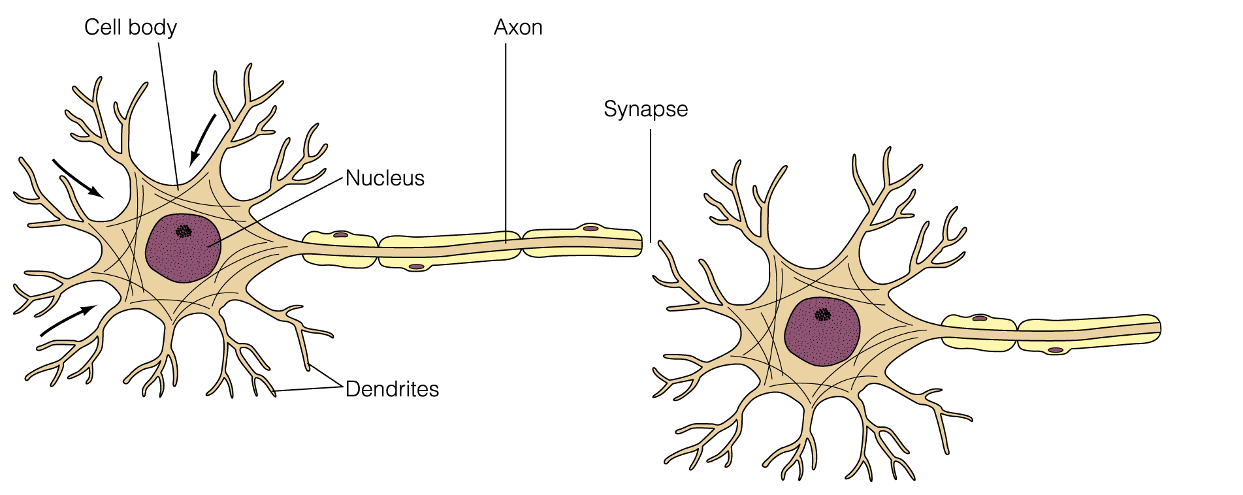
Artificial Neural Network
A series of connected neurons forms a pathway
A series of excited neurons creates a strong pathway
A biological neuron has multiple input tentacles called dendrites and one primary output tentacle called an axon
The gap between an axon and a dendrite is called a synapse

Slide 39
Artificial Neural Network
A neuron accepts multiple input signals and then controls the contribution of each signal based on the “importance” the corresponding synapse gives to it
The pathways along the neural nets are in a constant state of flux
As we learn new things, new strong neural pathways in our brain are formed

Slide 40
Artificial Neural Networks
Each processing element in an artificial neural net is analogous to a biological neuron
An element accepts a certain number of input values and produces a single output value of either 0 or 1
Associated with each input value is a numeric weight
If enough inputs are strong enough, it produces output.
The outputs strengthen or weaken, depending on experience.
The process of adjusting the weights and threshold values in a neural net is called training
A neural net can be trained to produce whatever results are required

Slide 41
Artificial Neural Networks
The effective weight of the element is defined to be the sum of the weights multiplied by their respective input values
v1*w1 + v2*w2 + v3*w3
Each element has a numeric threshold value
If the effective weight (weighted sum) exceeds the threshold, the unit produces an output value of 1
If it does not exceed the threshold, it produces an output value of 0

Slide 42
Artificial Neural Networks
W = 3
W = -2
Threshold
3
W = 5
W = -4
v1*w1 + v2*w2 + v3*w3 + …

Slide 43
Artificial Neural Networks
W = 2
Threshold
3
W = 5
W = 1
Threshold
2
W = 2
W = 2
Threshold
3
W = 3

Slide 44
Artificial Neural Networks
This is a cooperative process:
Some neurons say “I don’t know” ==> 0 for input
Some speak up strongly and their opinion is valued: high weighting
Some are clueless, so you do the opposite: negative weighting
Where do these weights and thresholds come from:
Training:
Initially random
Adjusted through backtracking to alter the values
Very long process
Outputs, then you say correct/incorrect
Much trail and error

Slide 45
A Problem
When a NN makes a decision, you have no way to ask why
Programmers will not know “how” decisions are made because there is no algorithm to trace.
DoD example…

Slide 46
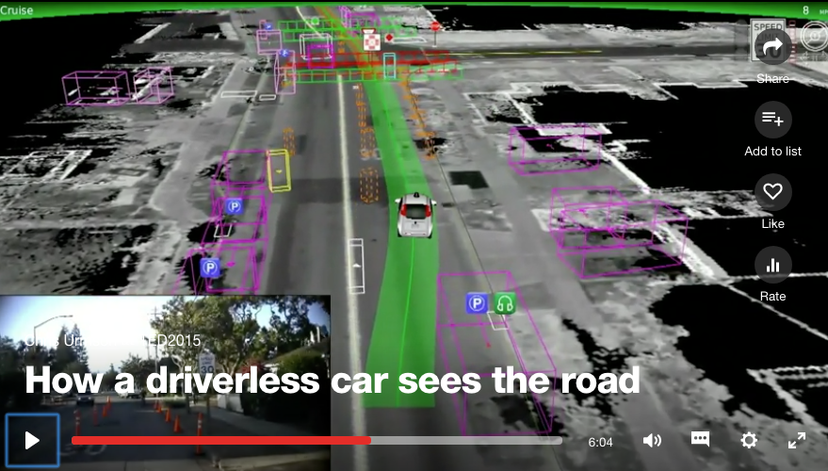
The future
“How a driverless car sees the road”
https://www.ted.com/talks/chris_urmson_how_a_driverless_car_sees_the_road#t-551834

